Slide 1
Behavior of material Chapter 6
SCHOOL OF MECHANICAL AND AEROSPACE ENGINEERING
Doan Manh Hung
Oct 10th, 2014

Slide 2
Chapter 6: Diffusion Mechanism
What are the two atomic mechanisms of diffusion?
How to distinguish between steady-state and non steady-state?
Fick’s first and second law equation form.
Factor that Influence Diffusion.
Diffusion in Ionic and Polymeric Material.

Slide 3
Diffusion
Phenomenon of material transport by atomic motion.
A diffusion couple, is formed by joining bars of two different metal together so that there is intimate contact between the two faces.
Impurity diffusion or inter-diffusion.
Self-diffusion.

Slide 4
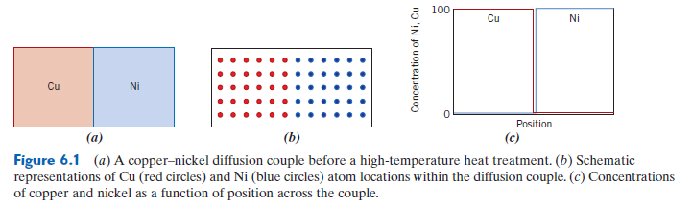
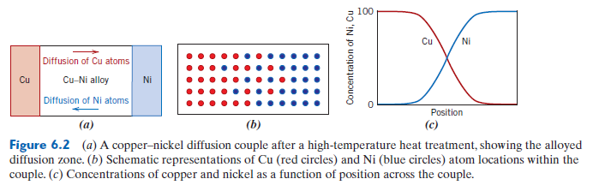
A copper-nickel diffusion couple

Slide 5
Diffusion Mechanism
Two condition:
There must be empty adjacent site.
The atom must have sufficient energy to break bonds with its neighbor atom and then cause some lattice distortion during the displacement.
Metallic diffusion:
Vacancy Diffusion
Interstitial Diffusion

Slide 6
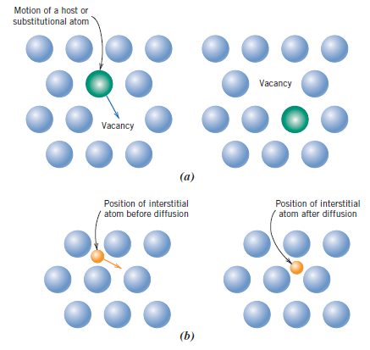
Vacancy Diffusion and Interstitial Diffusion

Slide 7
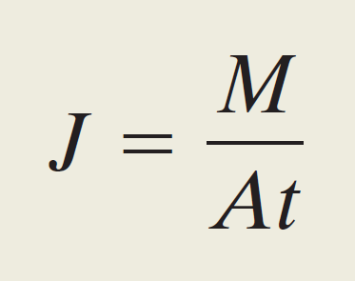

Diffusion flux
- Diffusion flux: how fast diffusion occur, or the rate of mass transfer.
Where:
M: mass.
A: area across.
t: diffusion time.
Unit: kg/$m^{2}.s$ or atoms/$m^{2}.s$

Slide 8
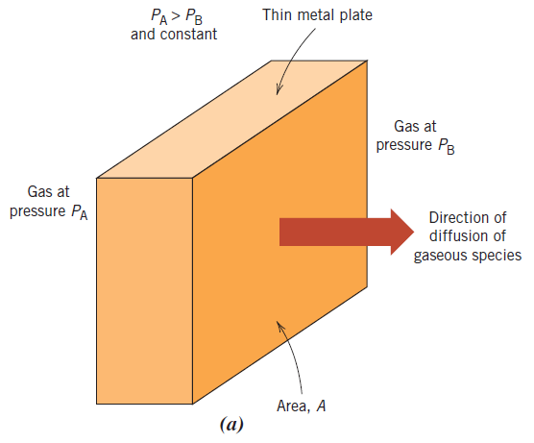
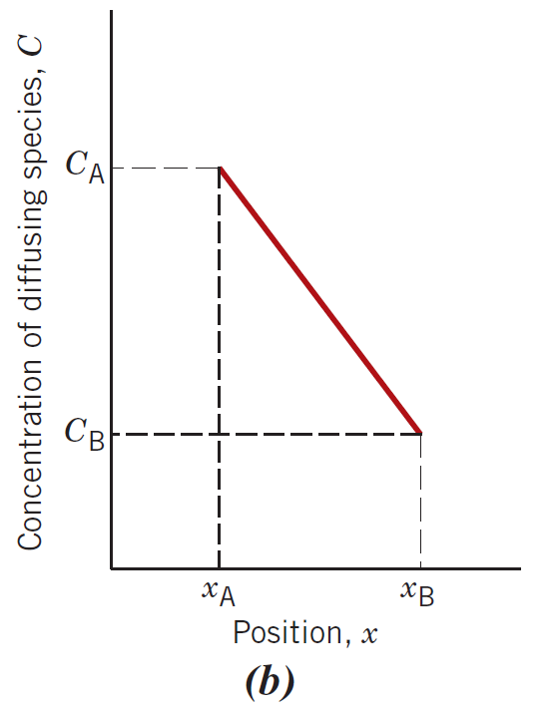
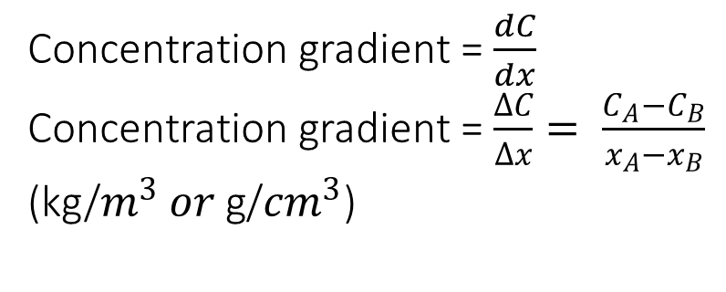
Steady-State Diffusion
Steady-State diffusion:
exist when the diffusion flux dose not change with time.
Concentration gradient = $\frac{dC}{dx}$
Concentration gradient = $\frac{∆C}{∆x}= \frac{C_{A}−C_{B}}{x_{A}−x_{B}}$
(kg/$m^{3} or \text{g}\text{/}{cm}^{3}$)

Slide 9
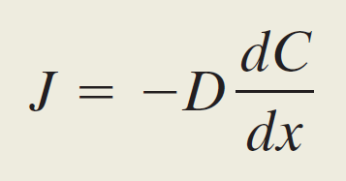
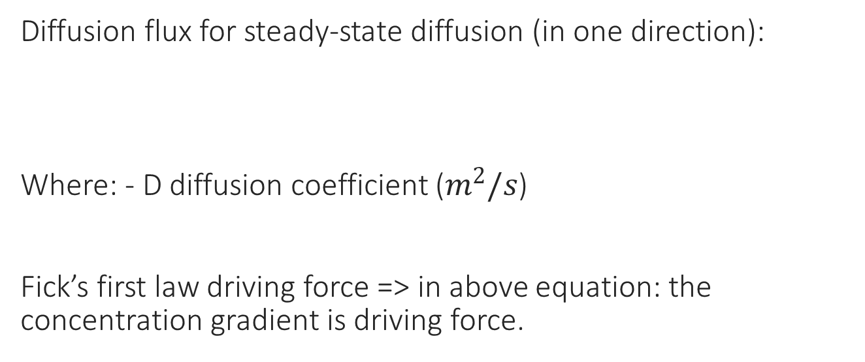
Fick’s first law
Diffusion flux for steady-state diffusion (in one direction):
Where: - D diffusion coefficient ($m^{2}/s$)
Fick’s first law driving force => in above equation: the concentration gradient is driving force.

Slide 10
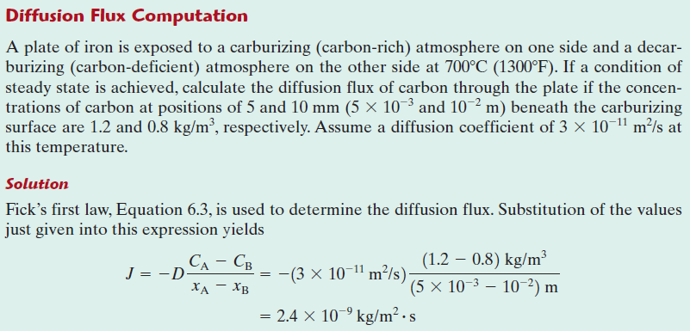
Example 1

Slide 11
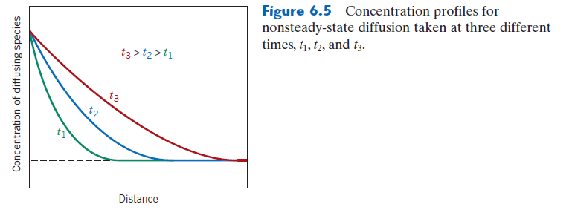
Non Steady-State Diffusion
The diffusion flux and the concentration gradient at some particular point in a solid vary with time, with a net accumulation or depletion of the diffusing species resulting.
Fick’s first law is no longer convenient => Fick’s second law

Slide 12
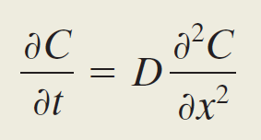
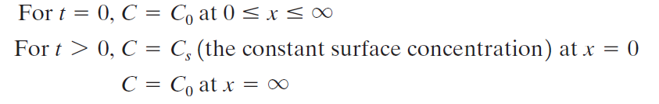

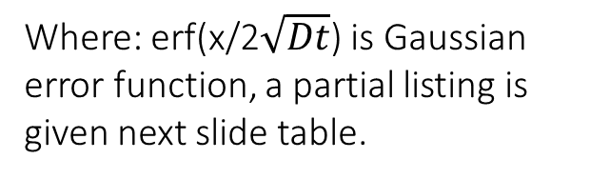
Fick’s second law
The solution are possible when physically meaningful boundary conditions are specified.
The B.C:
Apply B.C to equation above, have:
Where: erf(x/2$\sqrt{Dt}$) is Gaussian error function, a partial listing is given next slide table.

Slide 13
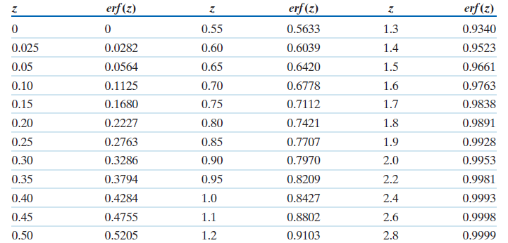
Tabulation of Error Function Values

Slide 14
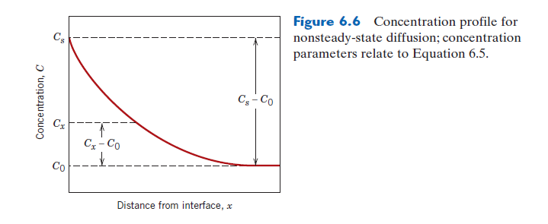
Concentration profile for non steady-state diffusion

Slide 15
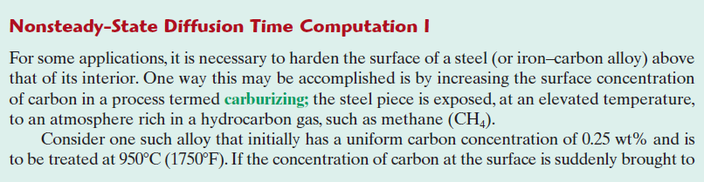
Example 2

Slide 16
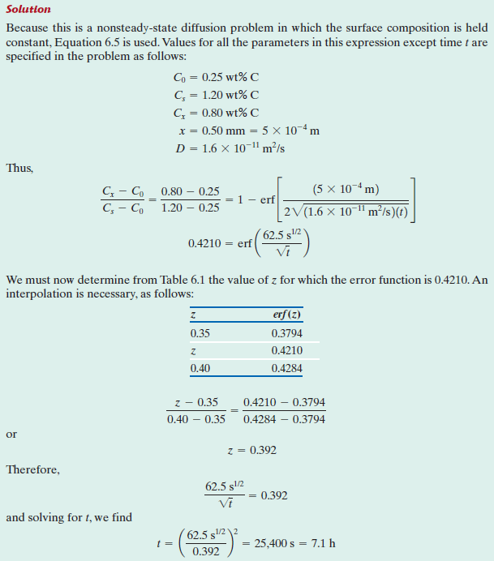

Slide 17
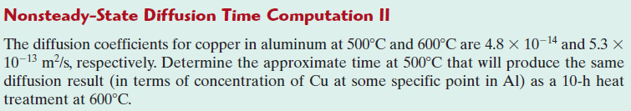
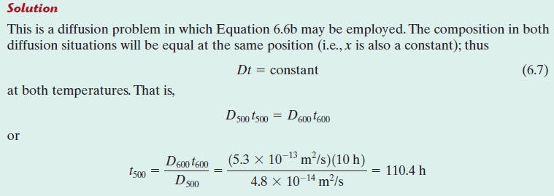
Example 3

